Slide 1
RepQuest Final Presentation
Dylan Hulon, Austin Jones, Benjamin Johnson, Jaylen Cook

Slide 2
Introduction
RepQuest is an Android-native App
Create and save custom workout templates
Upload and track history, stats, and goals
Earn XP through goals and progress
Motivate users and make workouts fun!
Notes:
… that allows users to enjoy exercising and living healthier.
Users can create…
And customize a personal avatar…
Users can earn…
Our goal is to…

Slide 3
Technology
Code developed in Android Studio, UI in Jetpack Compose
UI design and mockups created in Figma
Databases: SQLite, Firebase
GitHub, GitHub Desktop, Git for code accuracy and documentation
Discord to plan meetings and discuss other information
ChatGPT as technical guidance only when necessary, all coding done by hand
Notes:
Our code was developed… and the UI framework is…
Our UI design…
The databases used are…
SQLite enables offline storage, and Firebase facilitates data synchronization across sessions.
Team members are utilizing GitHub… Discord to… and ChatGPT… and all our coding is…

Slide 4
Design Overview
RepQuest is a Kotlin-based Android fitness tracking application built using Jetpack Compose for UI
Utilizes a Component-based architecture, persistence using an embedded database and Firebase Realtime Database for data backup
Notes:
It utilizes a component-based architecture and in-memory state management, and Firebase…

Slide 5
Design Overview 2
Core architectural components:
  NavigationDestination sealed class
  RepQuestApp composable
Data model layer:
  Exercise, Workout, Goals data classes
Workout management screens visible to users:
  WorkoutScreen, CreateWorkout, CreateExercise, WorkoutDetail and supporting Settings screen, History, and Stats
Notes:
The core architectural components are: …and the RepQuestApp composable which serves as the main entry point of the application
The data model layer consists of…
The workout management screens visible to the user consist of…

Slide 6
Core Components - NavigationDestination
NavigationDestination is a sealed class designed to define the navigation structure for the bottom bar, and supports adaptive layouts
Key components:
  Route
  Title
  Unselected icon
  Selected icon
Contains the five NavBar destination options:
  Workout
  History
  Stats
  Goals
  Settings
Notes:
…supports adaptive layouts using type-safe routing.
The key components are:
It also contains the options on located on the bottom navigation bar:

Slide 7
Core Components - RepQuestApp
RepQuestApp is designed to serve the application entry point
Manages navigation state and data flow through the application and implements the bottom NavBar
Manages states of:
  navController
  currentRoute
  pendingExercises
  savedWorkouts
Notes:
RepQuestApp is a composable root component that serves as the…
It manages…
It also manages the states of:
navController, which controls the navigation stack,
currentRoute which tracks the active screen for navigation highlighting,
pendingExercises which serves as temporary storage for in-progress exercises, and
savedWorkouts which is the in-memory workout persistence.

Slide 8
Core Components - RepQuestApp 2
Implements NavigationSuiteScaffold component for adaptive bottom or side rail navigation
A NavHost is used to map screen destinations to composable routes
Navigation arguments are passed via URLs, such as “workoutDetail/{workoutId}”
Notes:
The navigation configuration implements the NavigationSuiteScaffold component for adaptive bottom or side rail navigation
depending on the device running the application.

Slide 9
Data Model Layer
Contains three data class objects: Exercise, Workout, Goals
Exercise attributes: unique id, exercise name, # of sets, # of reps, weight, increment amount, rest time, and user notes
Workout attributes: unique id, workout name, list of type Exercise, date completed, and workout notes
Goals attributes: auto-generated unique id, goal name, target value, current value, boolean for completion, and awarded xp
Notes:
The data model layer contains…
…rest time between sets, and, optionally, user notes.
…unique id generated using the time of creation, and, optionally, workout notes.
…a boolean for whether the goal has been completed, and the gamification element of awarded experience points.

Slide 10
Presentation Layer
The Presentation Layer is comprised of the components presented to the user:
  Workout Screen
  Create Workout
  Create Exercise
  Workout Detail Screen
  Settings Screen
  History Screen
  Stats Screen

Slide 11
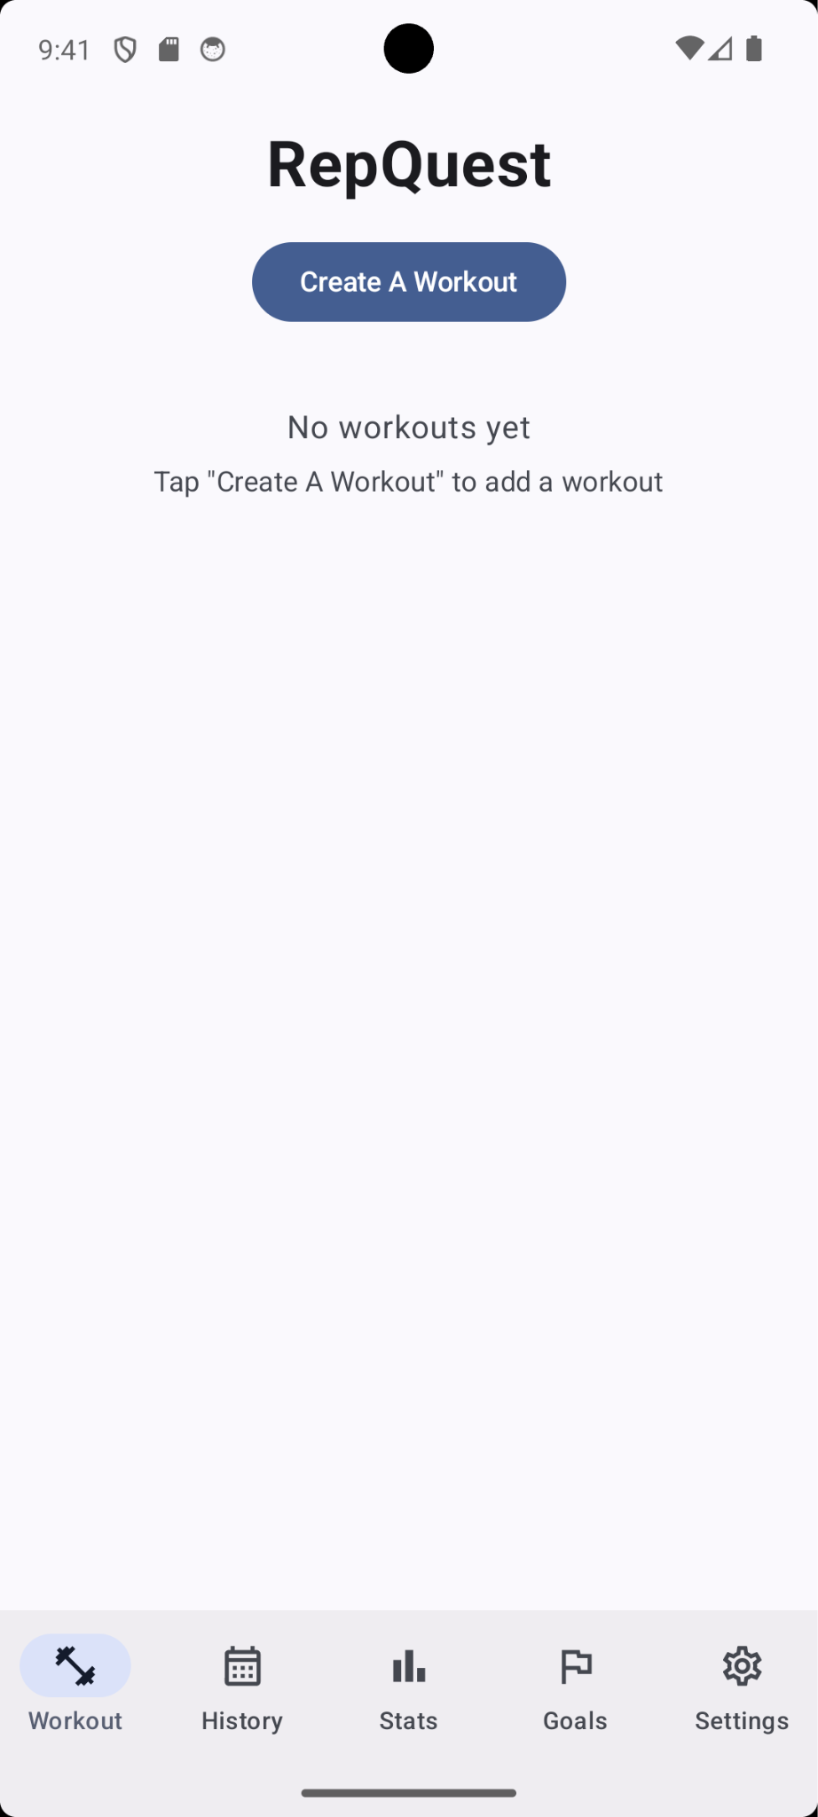
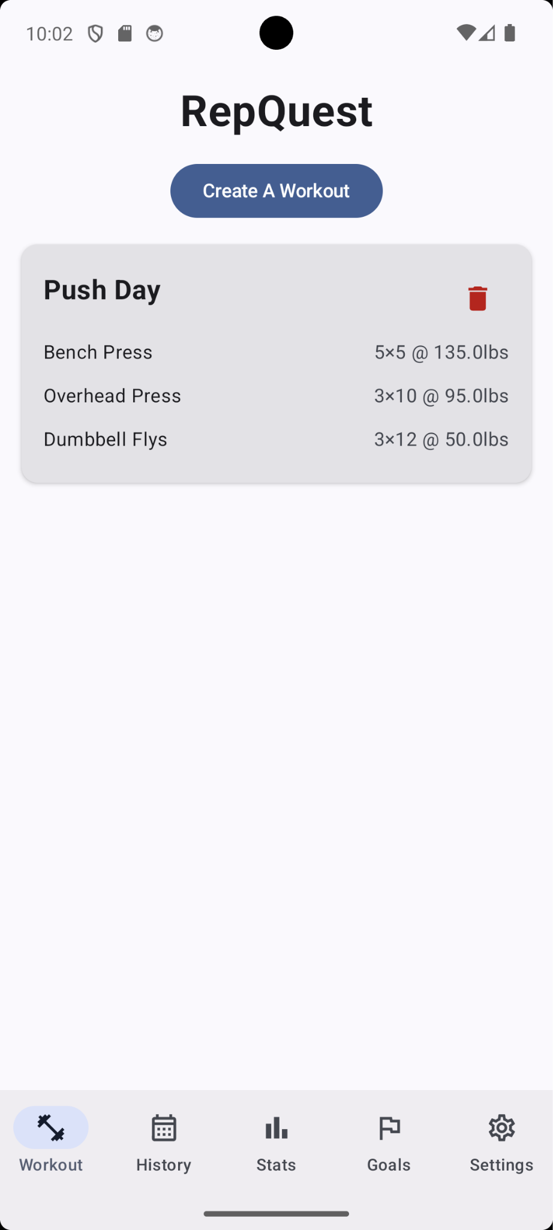
Presentation Layer - Workout Screen
The purpose of the Workout Screen is to be the main dashboard displaying all saved workouts.

Slide 12
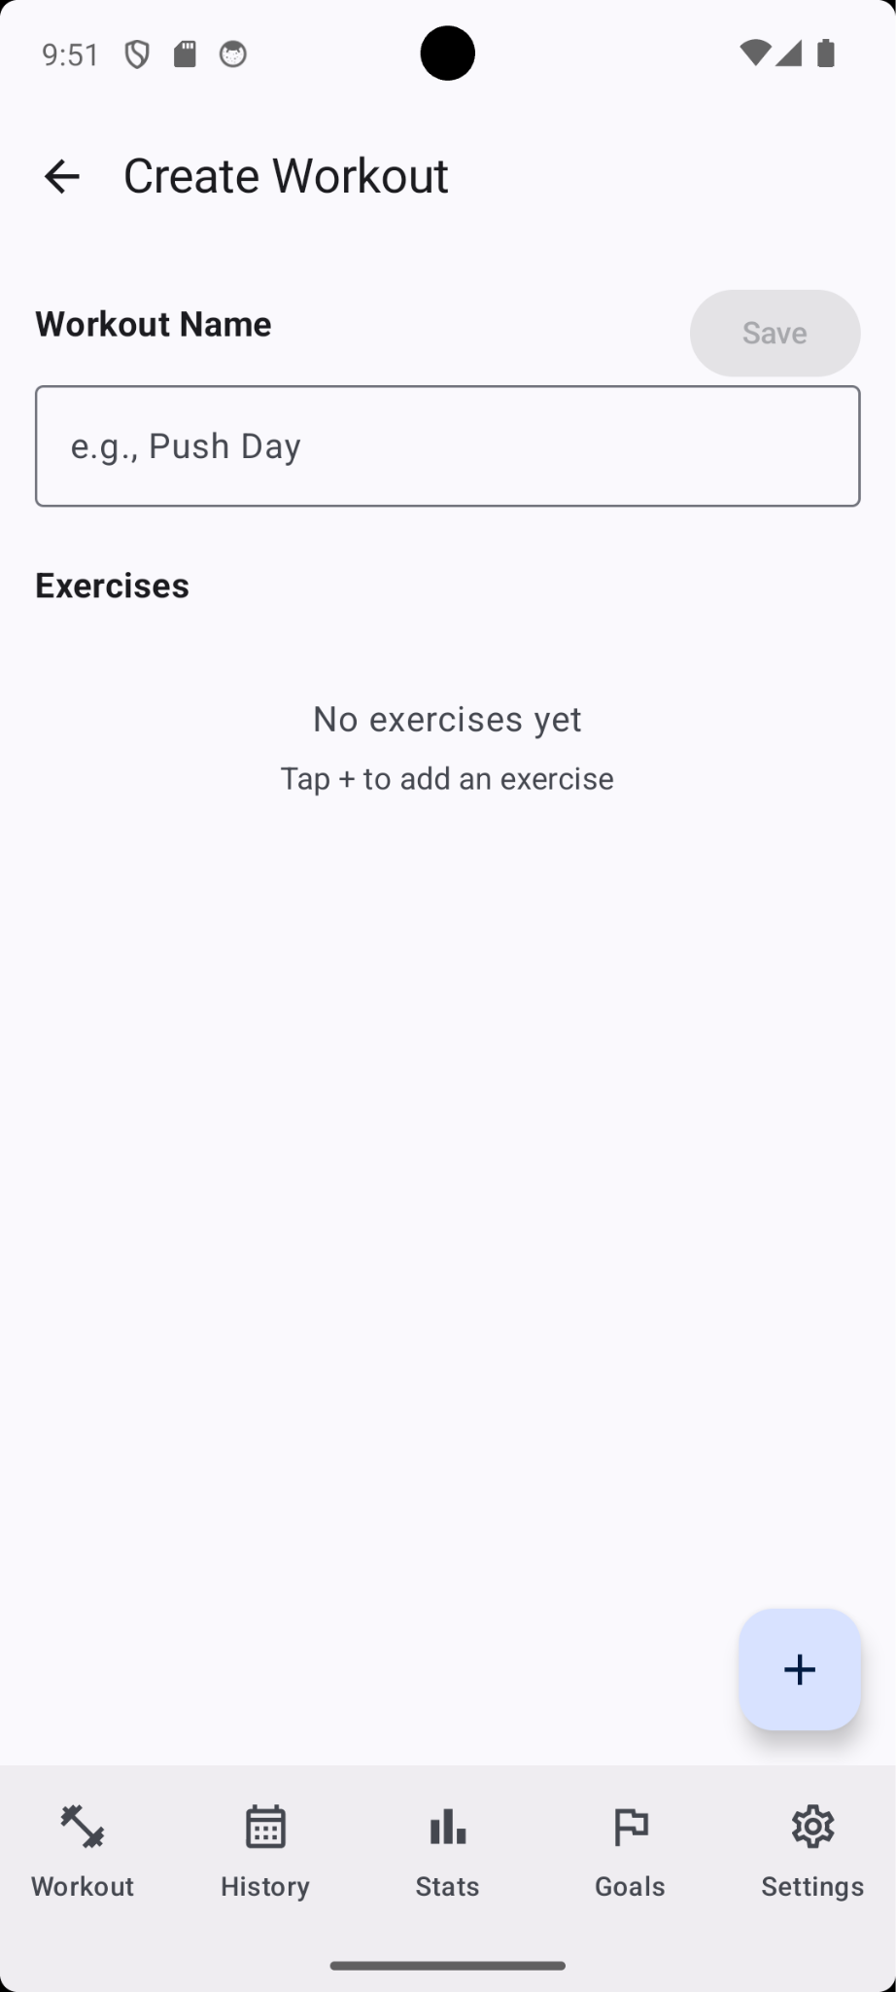
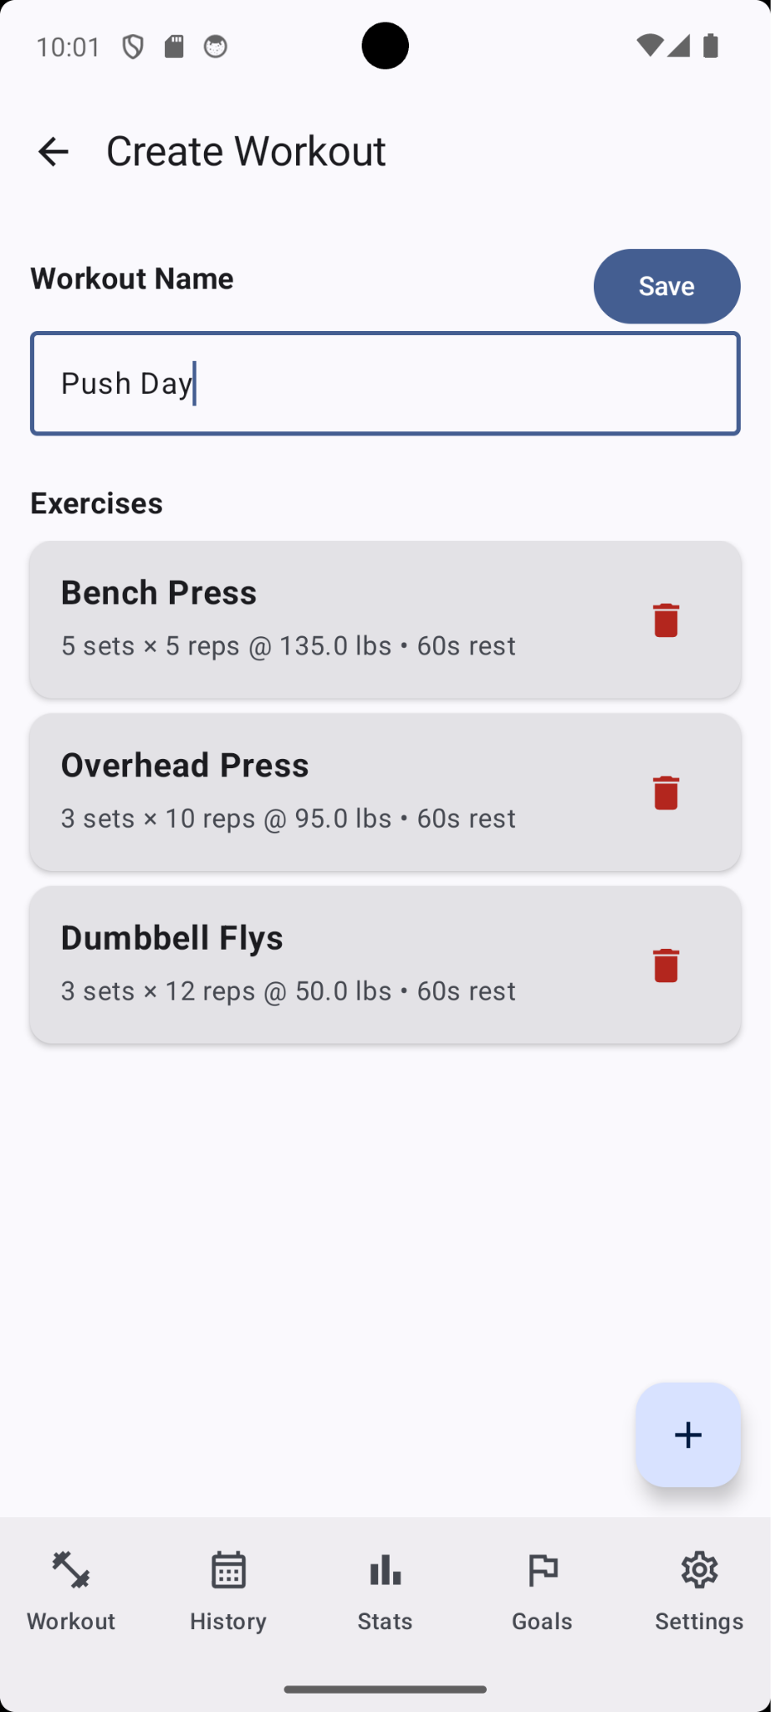
Presentation Layer - Create Workout
The Create Workout Screen is reached by clicking “Create A Workout” in the Workout Screen.

Slide 13
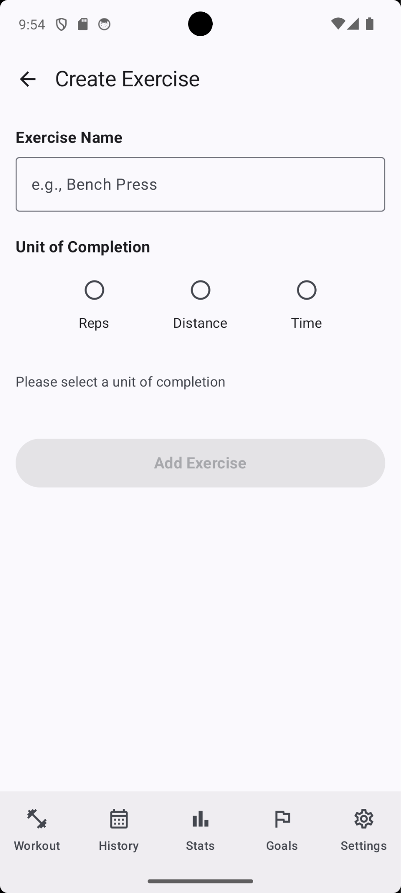
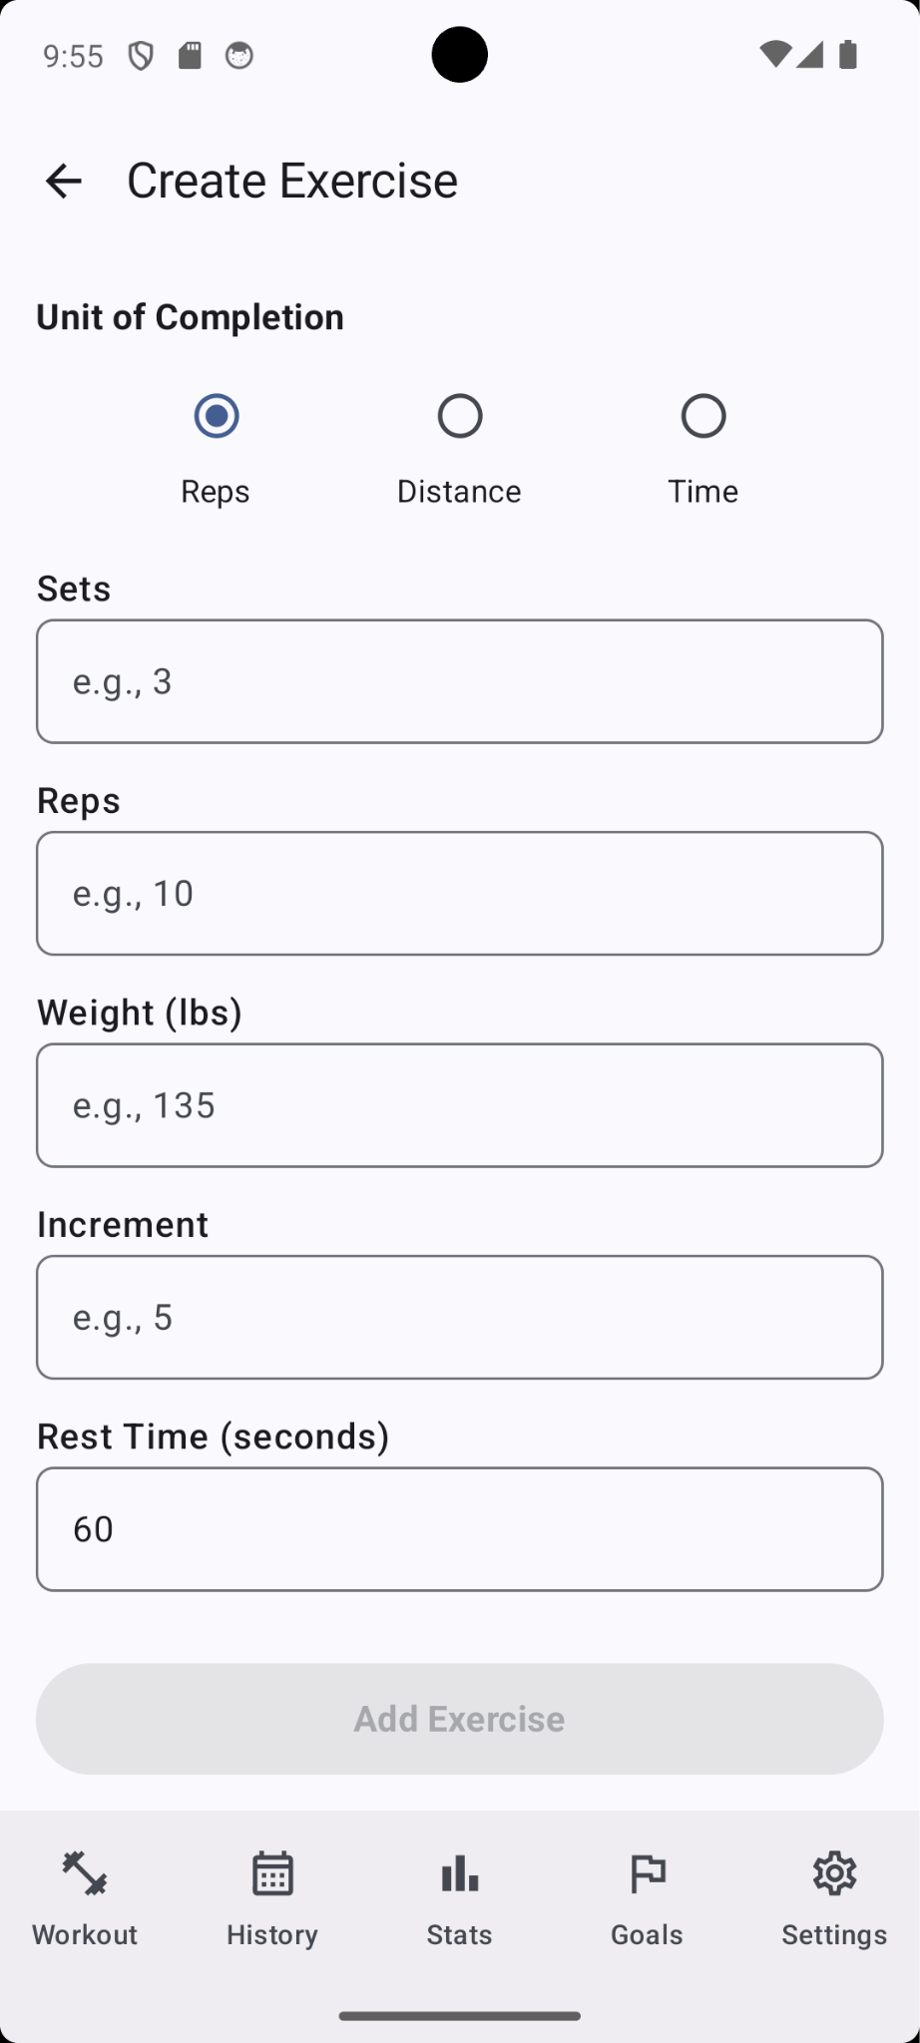
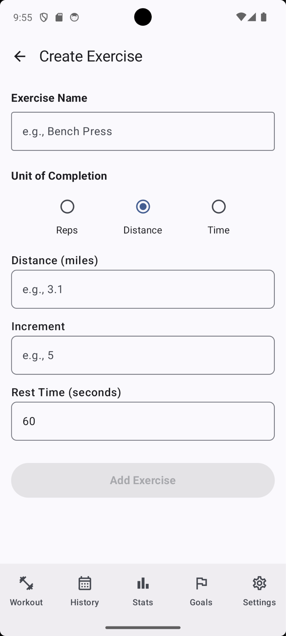
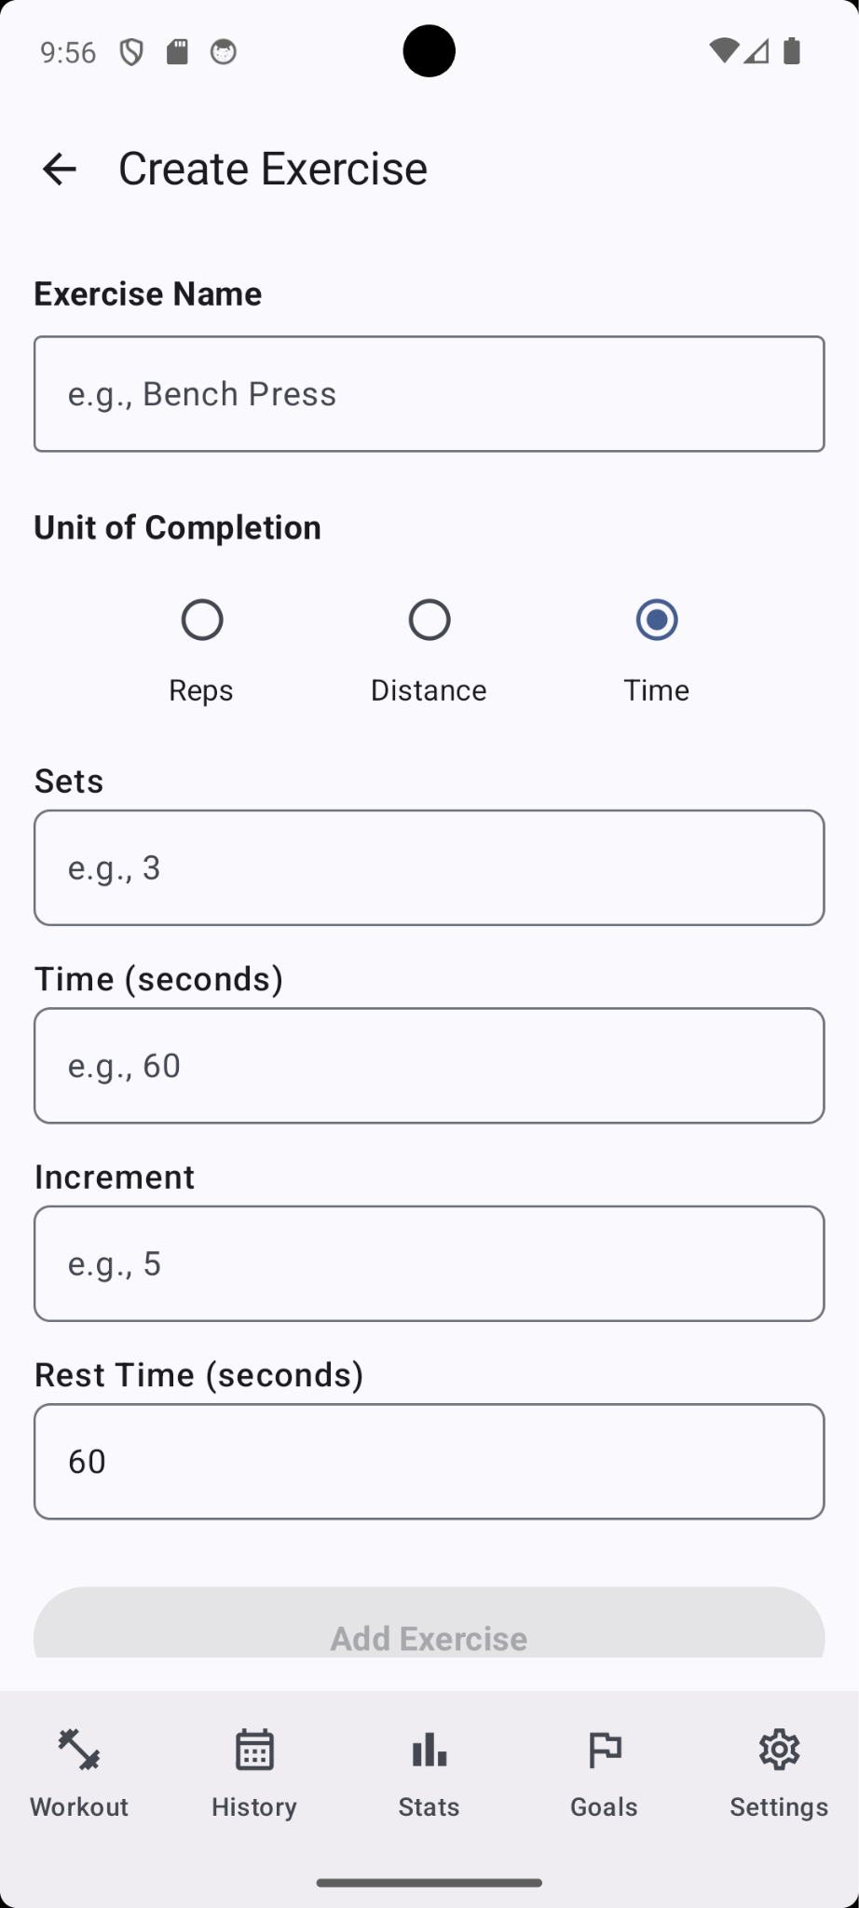
Presentation Layer - Create Exercise
The Create Exercise screen is reached by clicking the add exercise button on the Create Workout Screen and is used as an exercise creation form with dynamic fields.

Slide 14
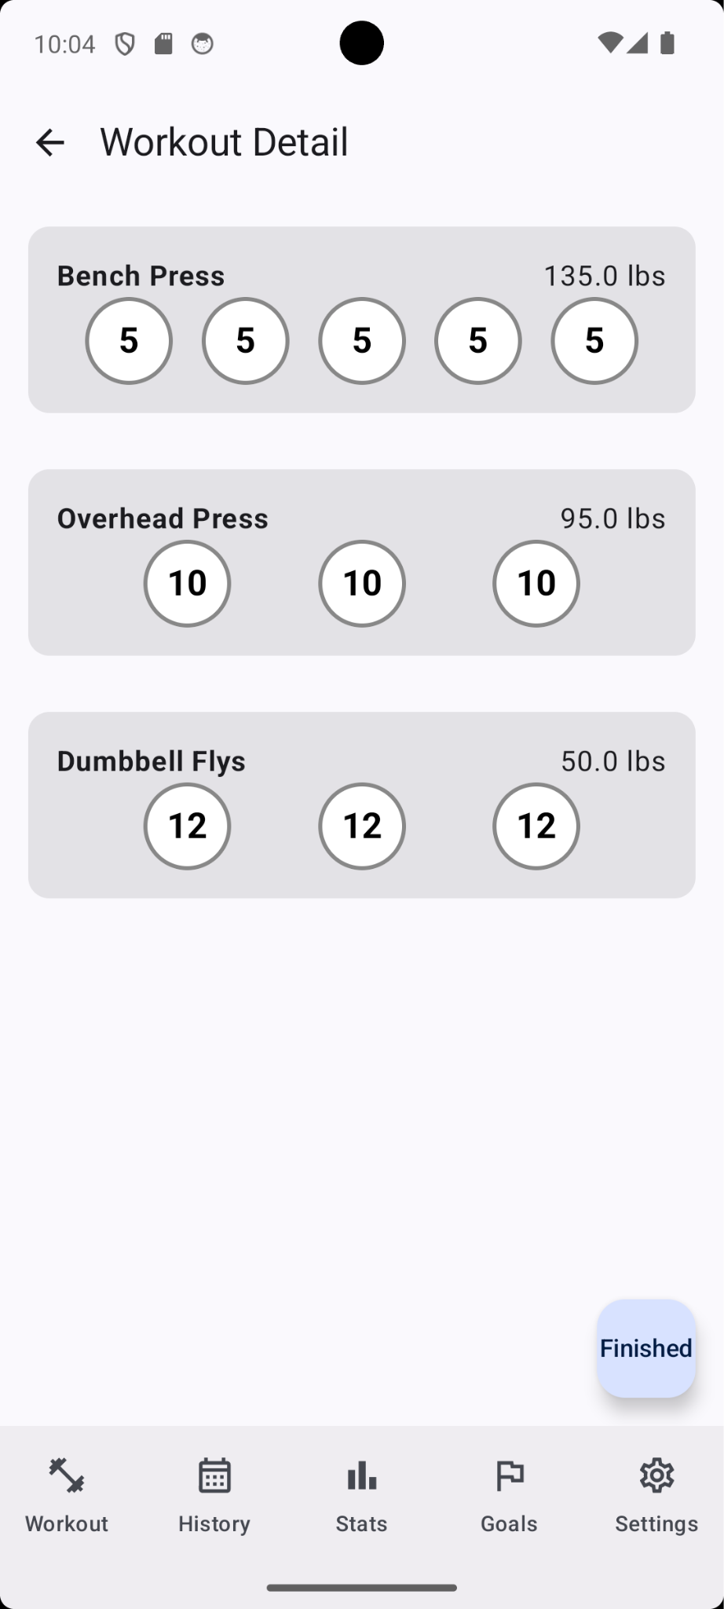
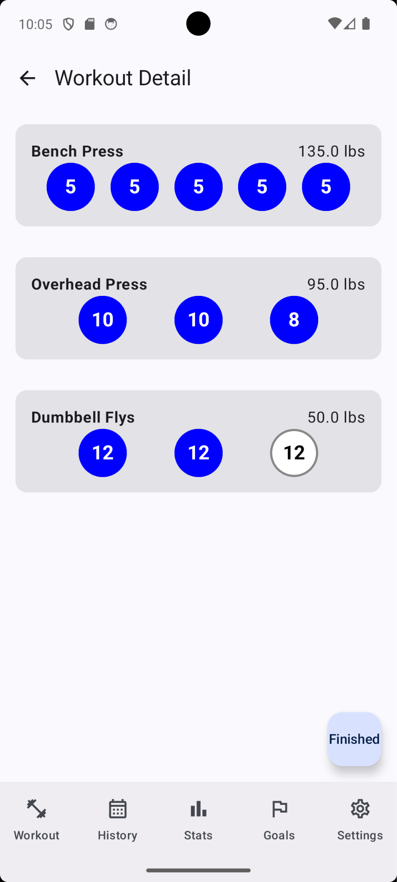
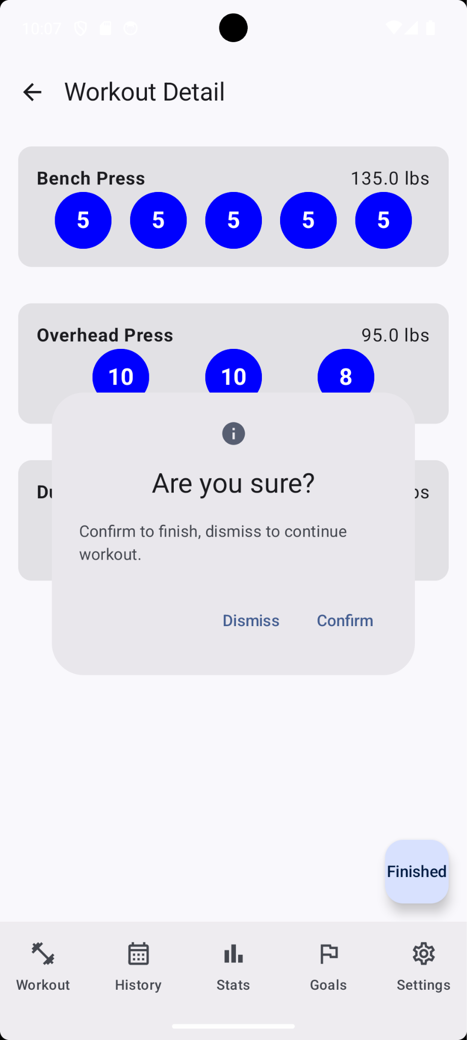
Presentation Layer - Workout Detail Screen
The Workout Detail Screen displays the exercises of a saved workout for active tracking of reps completed.

Slide 15
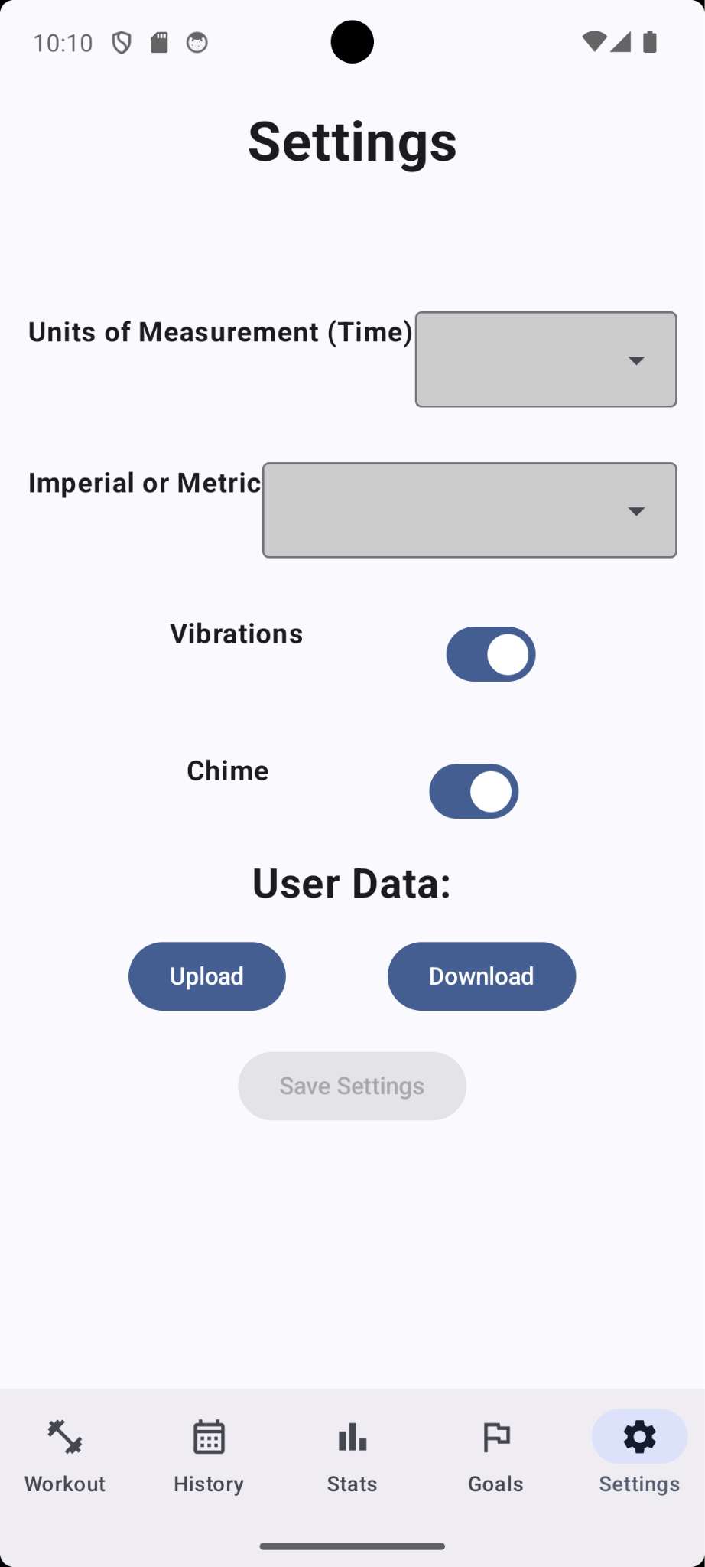
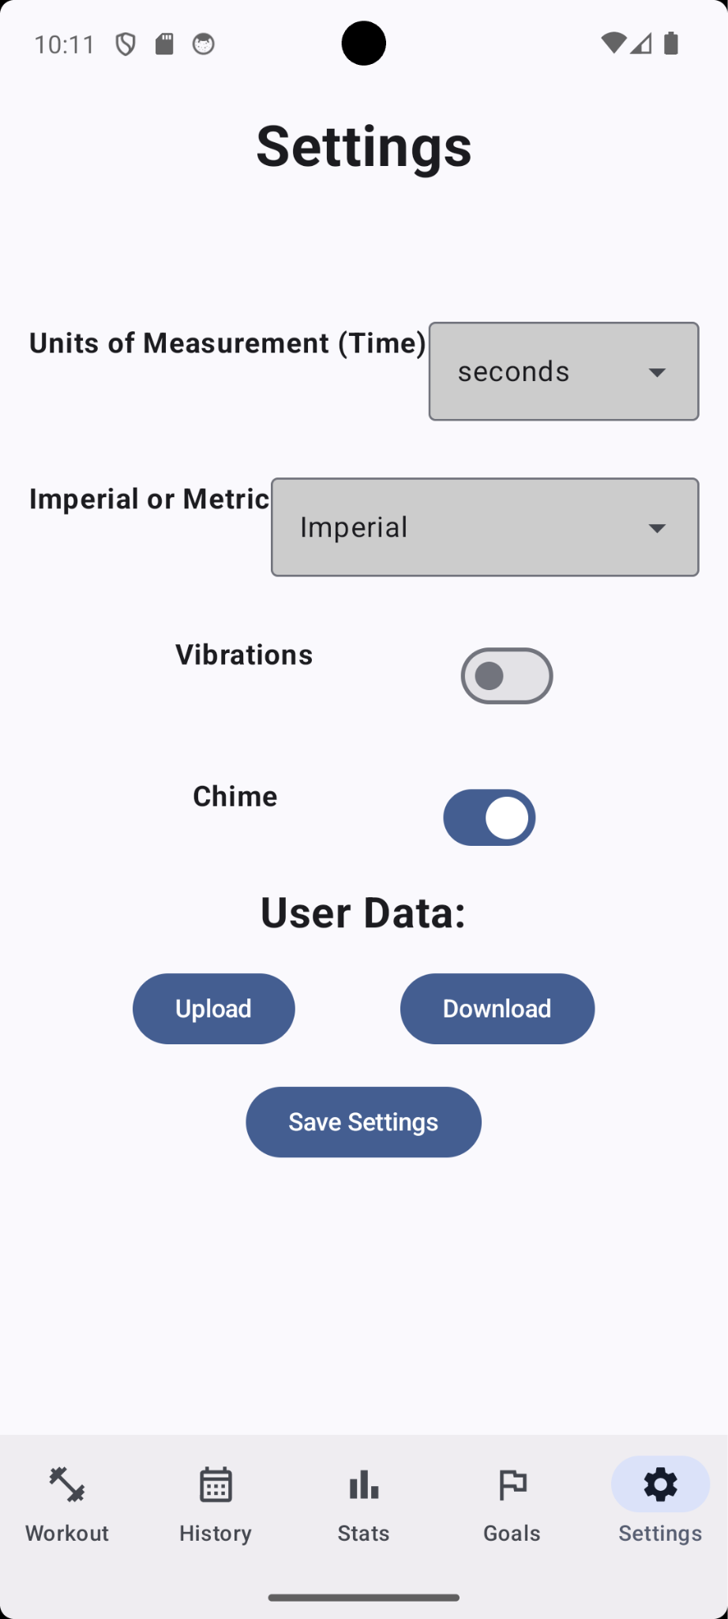
Presentation Layer - Settings Screen
The Settings Screen is used to allow the user to specify preferences for configuration elements.

Slide 16
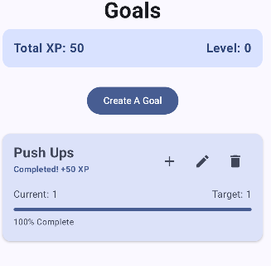
Presentation Layer - Goals Screen
Lets users create and manage their own fitness goals
Shows progress with a clear percent and progress bar
Finishing a goal grants the user 50 experience points (100 per level)
Easy buttons to update, edit, or delete a goal
Uses pop-up dialogs so the user can enter info smoothly
Makes tracking fitness progress feel fun and rewarding

Slide 17
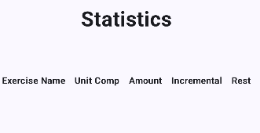
Presentation Layer - Stats Screens
Shows a summary of the user’s workout history
Shows all stats in a simple vertical list
Displays the most used goal for each exercise
Shows the highest goal the use has achieved per exercise
Trends are visualized through clear, easy-to-read charts
*Unfortunately the Statistics screen was not fully implemented due to time constraints.
Shows placeholder screen

Slide 18
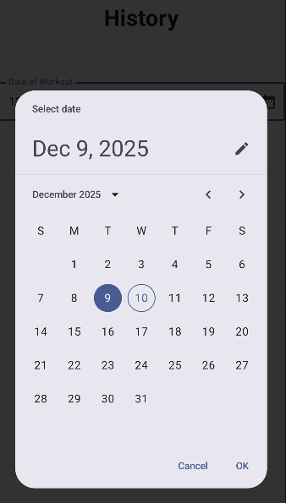
Presentation Layer - History
Lets the user pick a past workout date from a calendar-style date picker
Tapping a date shows the workout details for that specific day
Displays any notes the user saved for that workout in a text box
Helps users look back at previous workouts and track what they did over time

Slide 19
Thank you all for your time!
-RepQuest

